Slide 1
Frequent Itemset mining methods

Slide 2
Frequent Itemset mining methods
Data Mining plays an important role in the decision-making process. Insights from such pattern analysis offer vast benefits, including increased revenue, cost cutting, and improved competitive advantage.
To Mined hidden patterns of the frequent itemset become more time consuming , when the amount of data increases over the time.
Due to huge amount of data, significant memory consumption is needed in mining the hidden patterns of the frequent itemset.
Therefore, an efficient algorithm is required to mine the hidden patterns of the frequent itemset within a shorter run time and with less memory consumption while the volume of data increases over the time period.

Slide 3
frequent items
A frequent itemset is an itemset whose support is greater than some user-specified minimum support.
Frequent itemset mining leads to the discovery of associations and correlations among items in large transactional or relational data sets.
A typical example of frequent itemset mining is market basket analysis.

Slide 4
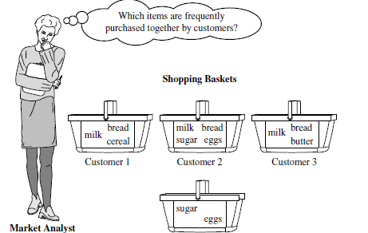

Slide 5

Market Basket Analysis
Suppose, as manager of any supper market /online shopping web portal, you would like to learn more about the buying habits of your customers.
Market basket analysis is a process that looks for relationships among entities and objects that frequently appear together, such as the collection of items in a shopper’s cart. For the purposes of customer centricity, market basket analysis examines collections of items to identify attractions or like-mindedness that are relevant within the different contexts of the customer touch points.

Slide 6
Some examples include
Product placement:
  Identifying products that may often be purchased together and arranging the placement of those close by to encourage the purchaser to buy both items. That placement can be physical, such as in the arrangement of products on near or adjoin location, or virtual, such as in a print catalog or on an e-commerce site.
Point-of-Sale
  Companies may use the like-mindedness grouping of multiple products as an indication that customers may be predisposed to buying certain sets of products at the same time.
  This enables the presentation of items for cross-selling, or may suggest that customers may be willing to buy more items when certain products are bundled together.

Slide 7
Some examples include
Customer retention:
  When customers contact a business to sever a relationship, a company representative may use market basket analysis to determine the right incentives to offer in order to retain the customer’s business.

Slide 8
Frequent pattern mining
Frequent pattern mining is most easily explained by introducing market basket analysis, a typical usage for which it is well-known.
Market basket analysis attempts to identify associations between the various items that have been chosen by a particular shopper or customer and placed in their market basket (be it real or virtual) and assigns support and confidence measures for comparison.
The value of this lies in cross-marketing and customer behaviour analysis.
The generalization of market basket analysis is frequent pattern mining and is actually quite similar to classification except that any attribute, or combination of attributes (and not just the class), can be predicted in an association. As association does not require the pre-labeling of classes, it is a form of unsupervised learning.

Slide 9
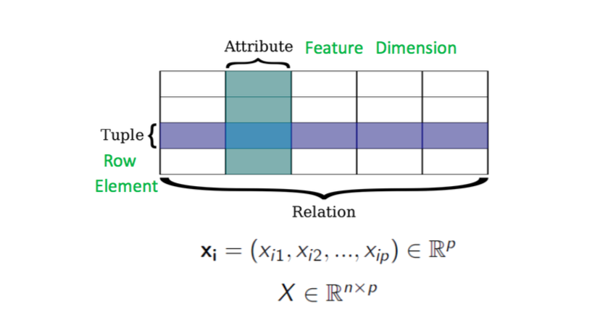
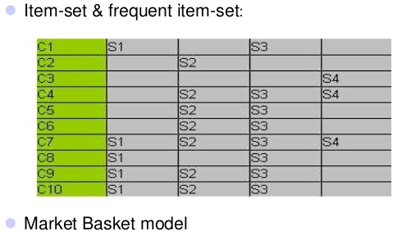
The data that we are going to deal with looks like this:

Slide 10
frequent items
transaction ID | items
1 | {A,C,D}
2 | {B,C,E}
3 | {A,B,C,E}
4 | {B,E}
5 | {A,B,C,E}
1-frequent:
{A} = 3;
{B} = 4;
{C} = 4;
{D} = 5;
{E} = 4;
2-frequent :
{A, B} = 2
{A, C} = 3
{A, D} = 3
{A,E} =
{B, C} = 3
{B, D} = 4
{B,E} =
{C, D} = 4
{C,E}=
{D,E} =
3-frequent:
4-frequent:

Slide 11
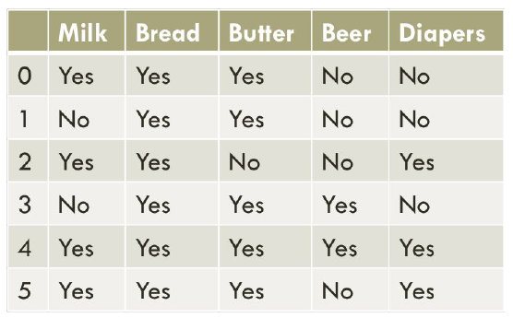
Association rules are if-then statements that help to show the probability of relationships between data items within large data sets in various types of databases. Association rule mining has a number of applications and is widely used to help discover sales correlations in transactional data or in medical data sets.

Slide 12
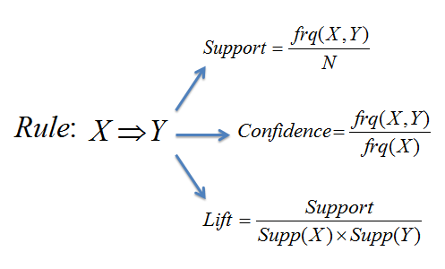
transaction ID | milk | bread | butter | Cold drink
1 | 1 | 1 | 0 | 0
2 | 0 | 0 | 1 | 0
3 | 0 | 0 | 0 | 1
4 | 1 | 1 | 1 | 0
5 | 0 | 1 | 0 | 0
Rule Evaluation Metrics –
Calculate the Support and confidence for itemset (milk, bread and butter)
Or Lift is
Support(X union Y)/ support(X)*support(Y)

Slide 13
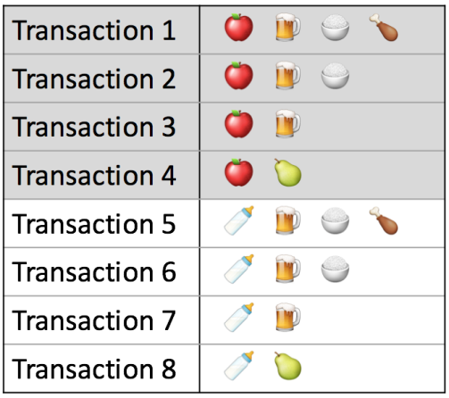


Support. This says how popular an itemset is, as measured by the proportion of transactions in which an itemset appears. the support of {apple} is 4 out of 8, or 50%. Itemsets can also contain multiple items
Confidence. This says how likely item Y is purchased when item X is purchased, expressed as {X -> Y}. This is measured by the proportion of transactions with item X, in which item Y also appears.
the confidence of {apple -> beer} is 3 out of 4, or 75%.

Slide 14

Lift. This says how likely item Y is purchased when item X is purchased, while controlling for how popular item Y is. the lift of {apple -> beer} is 1,which implies no association between items. A lift value greater than 1 means that item Y is likely to be bought if item X is bought, while a value less than 1 means that item Y is unlikely to be bought if item X is bought.

Slide 15
transaction ID | milk | bread | butter | Cold drink
1 | 1 | 1 | 0 | 0
2 | 0 | 0 | 1 | 0
3 | 0 | 0 | 0 | 1
4 | 1 | 1 | 1 | 0
5 | 0 | 1 | 0 | 0
Count
Support (Milk) =
Support (bread) =
Support (butter) =
Support (Cold drink) =
Support (Milk, Bread) =
Support (Milk, butter)=
Support (Milk, Cold drink) =

Slide 16
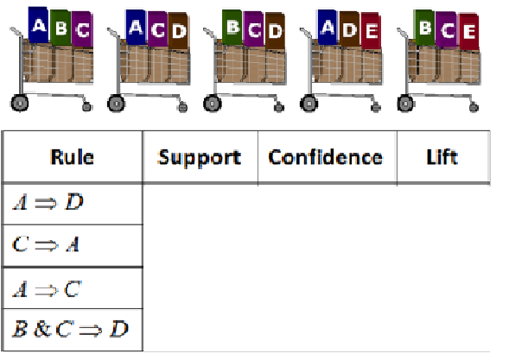

Slide 17
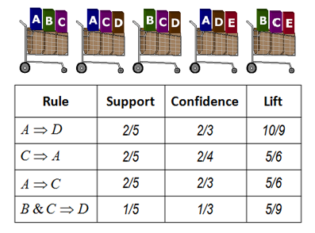

Slide 18
Transaction ID | Onion | Potato | Burger | Milk | Beer
t1 | 1 | 1 | 1 | 0 | 0
t2 | 0 | 1 | 1 | 1 | 0
t3 | 0 | 0 | 0 | 1 | 1
t4 | 1 | 1 | 0 | 1 | 0
t5 | 1 | 1 | 1 | 0 | 1
t6 | 1 | 1 | 1 | 1 | 1
There are multiple rules possible even from a very small database, so in order to select the interesting ones, we use constraints on various measures of interest and significance.

Slide 19
Association Rules
The total set of items available in set then each item can be represented by a Boolean variable, representing whether or not the item is present within a given “basket.”
Each basket is then simply a Boolean vector, possibly quite lengthy dependent on the number of available items.
A dataset would then be the resulting matrix of all possible basket vectors.

Slide 20
Important Definitions
Support : It is one of the measure of interestingness. This tells about usefulness and certainty of rules. 5% Support means total 5% of transactions in database follow the rule.
  Support(A -> B) = Support_count(A∪B)
Confidence: A confidence of 60% means that 60% of the customers who purchased a milk and bread also bought butter.
  Confidence(A -> B) = Support_count(A∪B) / Support_count(A)
If a rule satisfies both minimum support and minimum confidence, it is a strong rule.

Slide 21
Association Rule Definitions
Set of items: I={I₁,I₂,…,I_{m}}
Transactions: D={t₁,t₂, …, t_{n}}, t_{j}⊆ I
Itemset: {I_{i1},I_{i2}, …, I_{ik}} ⊆ I
Support of an itemset: Percentage of transactions which contain that itemset.
Large (Frequent) itemset: Itemset whose number of occurrences is above a threshold.

Slide 22

Association rule
Association rule learning is a popular and well researched method for discovering interesting relations between variables in large databases. In Association rule learning describes analyzing and presenting strong rules discovered in databases using different measures of interestingness. Based on the concept of strong rules, introduced association rules for discovering regularities between products in large-scale transaction data recorded by point-of-sale (POS) systems in supermarkets.
For example, the rule found in the sales data of a supermarket would indicate that if a customer buys onions, potatoes cabbage together, he or she is likely to also buy Pizza base. Such information can be used as the basis for decisions about marketing activities such as, e.g., promotional pricing or product placements.

Slide 23
Applications of Association Rule Mining
Basket data analysis - is to analyze the association of purchased items in a single basket or single purchase as per the examples given above.
Cross marketing - is to work with other businesses that complement your own, not competitors. For example, vehicle dealerships and manufacturers have cross marketing campaigns with oil and gas companies for obvious reasons.
Catalog design - the selection of items in a business’ catalog are often designed to complement each other so that buying one item will lead to buying of another. So these items are often complements or very related.
Analyzing and Predicting customer behavior

Slide 24
How association rules work
Association rule mining, at a basic level, involves the use of machine learning models to analyze data for patterns, or co-occurrence, in a database. It identifies frequent if-then associations, which are called association rules.
An association rule has two parts: an predecessor (if) and a resultant (then). An predecessor is an item found within the data. A resultant is an item found in combination with the predecessor.
Association rules are created by searching data for frequent if-then patterns and using the criteria support and confidence to identify the most important relationships.

Slide 25
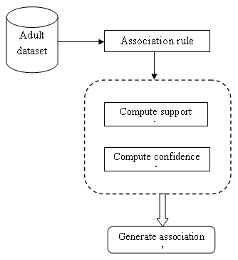
How association rules work
Support is an indication of how frequently the items appear in the data. Confidence indicates the number of times the if-then statements are found true. A third metric, called lift, can be used to compare confidence with expected confidence.

Slide 26
Association Rule Mining
Given a set of transactions, find rules that will predict the occurrence of an item based on the occurrences of other items in the transaction
Market-Basket transactions
Example of Association Rules
{Diaper} → {Beer},
{Milk, Bread} → {Eggs,Coke},
{Beer, Bread} → {Milk},
Implication means co-occurrence, not causality!

Slide 27
Definition: Frequent Itemset
Itemset
  A collection of one or more items
    Example: {Milk, Bread, Diaper}
  k-itemset
    An itemset that contains k items
Support count (σ)
  Frequency of occurrence of an itemset
  E.g. σ({Milk, Bread,Diaper}) = 2
Support
  Fraction of transactions that contain an itemset
  E.g. s({Milk, Bread, Diaper}) = 2/5
Frequent Itemset
  An itemset whose support is greater than or equal to a minsup threshold

Slide 28
Definition: Association Rule
Association Rule
  An implication expression of the form X → Y, where X and Y are itemsets
  Example:
  {Milk, Diaper} → {Beer}
Rule Evaluation Metrics
  Support (s)
    Fraction of transactions that contain both X and Y
  Confidence (c)
    Measures how often items in Y
    appear in transactions that
    contain X
Example:

Slide 29
Association rule algorithms
Popular algorithms that use association rules include :
  Apriori algorithm
  FP-Growth algorithm
  EClaT algorithm
  Tree Projection algorithm
  COFI algorithm
  TM algorithm
  P-Mine algorithm
  LP-Growth algorithm

Slide 30


Mining Association Rules
Two-step approach:
  Frequent Itemset Generation
    Generate all itemsets whose support ≥ minsup
  Rule Generation
    Generate high confidence rules from each frequent itemset, where each rule is a binary partitioning of a frequent itemset
Frequent itemset generation is still computationally expensive

Slide 31
Frequent Itemset Generation
Given d items, there are 2^{d} possible candidate itemsets

Slide 32
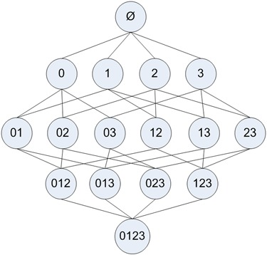
Frequent Itemset Generation

Slide 33
Frequent Itemset Generation Strategies
Reduce the number of candidates (M)
  Complete search: M=2^{d}
  Use pruning techniques to reduce M
Reduce the number of transactions (N)
  Reduce size of N as the size of itemset increases
  Used by DHP and vertical-based mining algorithms
Reduce the number of comparisons (NM)
  Use efficient data structures to store the candidates or transactions
  No need to match every candidate against every transaction

